Slide 1
Requirement Engineering
TELECOM Nancy 2024-2025

Slide 2
Sources
Software Engineering 10 - Ian Sommerville - Pearson
Applying UML and Patterns - Craig Larman
Software Requirements (Third Edition) - Wiegers and Beatty
Requirement Engineering – Dick, Hull and Jackson 2017 – Springer
Software Engineering A Practitioner’s Approach (Ninth Edition) – Pressman - Maxim

Slide 3
Topic covered
Requirement Analysis
Requirement Analysis Approaches
Requirement Elicitation techniques
Requirement Specification
Requirement Verification and Validation
Requirement Management
Modeling techniques
Requirement Tools
Trends

Slide 4
What is a requirement ?
The IEEE Standard Glossary of Software Engineering Terminology defines a requirement as:^{[1]}
A condition or capability needed by a user to solve a problem or achieve an objective.
A condition or capability that must be met or possessed by a system or system component to satisfy a contract, standard, specification, or other formally imposed document.
A documented representation of a condition or capability as in 1 or 2.
What the system should do and the constraints of its operations
IEEE Computer Society (1990). "IEEE Standard Glossary of Software Engineering Terminology". IEEE Standard.

Slide 5
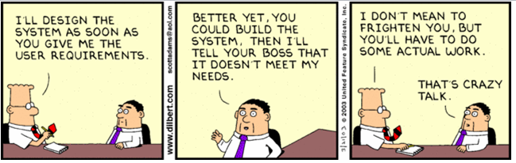
Requirements in practice
A user describes his/her needs, requirements specification to in a specification document
The software developer take the specification document and produce a piece of software thet meet these needs perfectly
What could go wrong ?

Slide 6
Use case for the course :
We want to develop a shopping platform to allow local producers to sell their products to consumers (aka thefoodassembly)
Producers are registered to an assembly. Every week they propose their product with a quantity and a price
Consumers can list the products and decide what they need
At some predefined day, producers deliver their product to the assembly and consumer can gather to collect their products.
An assembly manager is in charge to organize the distribution
The platform manager operate and maintain the system

Slide 7
Requirement
Description of the required functionnality
A client can add a product to his shopping basket
Details of realisation
The product is added to the basket
For some product, the client can select a quantity. The quantity is limited by the available stock
The total cost of the basket is updated
The product stock is updated provisionally
Requirements may have different priorities
High, medium, low
Shall vs should

Slide 8
Requirement v2
Description of the required functionnality
The system shall allows the client to select a product and add it to the basket
Details of realisation
The product is added to the basket
For some product, the client can select a quantity. The available stock limits the quantity
The total cost of the basket is updated
The product stock is updated provisionally
Requirements may have different priorities
High, medium, low
Shall vs should

Slide 9
Properties of a requirement
Unambiguous
Verifiable
Clear
Correct
Understandable
Feasible
Independent
Atomic
Necessary
Implementation-free
Consistent
Non Redundant
Complete
https://www.informit.com/articles/article.aspx?p=1152528&seqNum=4

Slide 10
Unambiguous
Only one way to interpret the requirement
A client shall be able to change the command at any time
What means « change the command »
What means « at any time »

Slide 11

Verifiable
It should be possible to test that a requirement is implemented correctly
Be careful to word that are difficult to test : efficient, simple, user-friendly, flexible, quickly
The system should be easy to use

Slide 12

Understandable
Requirements must be grammatically correct and written in a consistent style
The system must allow users cancel their command
User must allow to chose among products

Slide 13

Atomic
The requirement should contain a single traceable element: It will be difficult to trace a requirement that includes several requirements
The producer shall be able to manage its products list
Manage = add, update, delete ?

Slide 14

Implementation-Free
Requirements should not contain unnecessary design and implementation information:
The system must use CSV files to store assembly informations

Slide 15

Non-Redundant
Each requirement should be expressed only once and should not overlap with another requirement:
The producer shall be able to change the price of products
The producer shall be able to modify products and change their prices

Slide 16
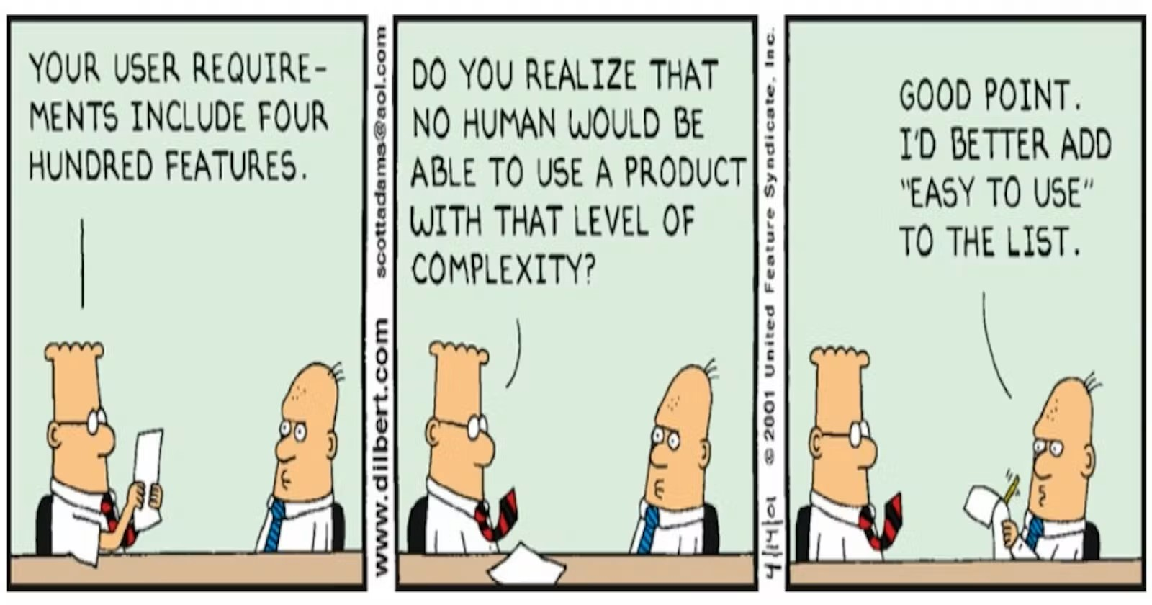

Slide 17
Requirement Analysis Approaches
Waterfall Model
Agile Approaches and Iterative methods
Hybrid Approaches and tailored methods

Slide 18
Waterfall Model
Requirements
Design
Implementation
Testing
Operation and Maintenance

Slide 19
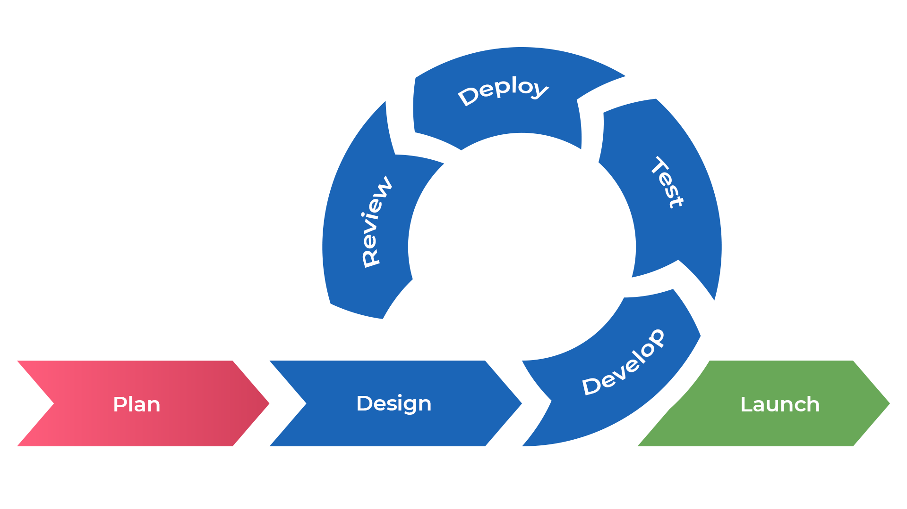
Agile Approaches and Iterative Methods

Slide 20

Stakeholders Analysis
Any person or organization who is affected by the system in some way and so who has a legitimate interest, direct or indirect
Stakeholder types
End users
System managers
System owners
External stakeholders

Slide 21
Stakeholder analysis
Identify
Identify the stakeholders
Prioritize
Prioritize the stakeholders
Determine
Determine stakeholders expectations
Analyze
Analyze stakeholders impact
Develop
Develop a stakeholders management plan
Implement
Implement stakeholders management plan
Notes:
Stakeholder analysis is a process that helps identify the stakeholders involved in a project, their interests, and their level of influence on the project. Here's a step-by-step guide to conducting a stakeholder analysis:
Identify the stakeholders: Make a list of all the individuals or groups who are affected by or have an interest in the project. This can include project sponsors, project team members, customers, end-users, suppliers, regulators, and other parties who have a stake in the project's outcome.
Prioritize the stakeholders: Analyze the stakeholders on the list and prioritize them based on their level of interest in the project and their level of influence over the project's success. Interest can be gauged by the extent to which the project affects the stakeholder or how interested they are in the project. Influence can be assessed based on their decision-making power, expertise, or the resources they control.
Determine stakeholder expectations: Identify the stakeholders' expectations of the project, including their goals, requirements, concerns, and potential conflicts. This information can be gathered through interviews, surveys, and other forms of communication.
Analyze stakeholder impact: Analyze the potential impact of each stakeholder on the project. This includes identifying how their interests and expectations align or conflict with the project's goals, and assessing the potential risks and opportunities they pose to the project's success.
Develop a stakeholder management plan: Develop a plan to manage stakeholder engagement throughout the project's lifecycle. This plan should outline how to communicate with stakeholders, how to involve them in decision-making, how to address conflicts, and how to ensure that their expectations are met.
Implement stakeholder management plan: Implement the stakeholder management plan by communicating with stakeholders, involving them in decision-making, and addressing their concerns throughout the project's lifecycle.
By conducting a stakeholder analysis, project teams can better understand the needs and expectations of their stakeholders, identify potential conflicts, and develop strategies to manage stakeholder engagement effectively.

Slide 22
Who are the stackholders for our example ?
Consumers
Producers
Assembly managers
Platform managers
Platform operators

Slide 23
Functional vs non-functional requirements
Functional Requirements
Non-Functional Requirements
Domain requirements

Slide 24
Functional and non-functional requirements
Functional requirements
Statements of services the system should provide, how the system should react to particular inputs and how the system should behave in particular situations.
May state what the system should not do.
Non-functional requirements
Constraints on the services or functions offered by the system such as timing constraints, constraints on the development process, standards, etc.
Often apply to the system as a whole rather than individual features or services.
Domain requirements
Constraints on the system from the domain of operation

Slide 25
Functional requirements
Describe functionality or system services.
Depend on the type of software, expected users and the type of system where the software is used.
Functional user requirements may be high-level statements of what the system should do.
Functional system requirements should describe the system services in detail.

Slide 26

Example of functional requirements
The consumer shall be able to remove a product from its basket
The product stock is updated
The cost of the basket is updated
The producer shall be able to update the remaining stock of a product during a selling session
The stock is updated
If too many consumers have already ordered the product, the most recent orders are updated until the stock returns to a 0.
Consumers are notified

Slide 27
Non-functional requirements
These define system properties and constraints e.g. reliability, response time and storage requirements. Constraints are I/O device capability, system representations, etc.
Process requirements may also be specified mandating a particular IDE, programming language or development method.
Non-functional requirements may be more critical than functional requirements. If these are not met, the system may be useless.

Slide 28
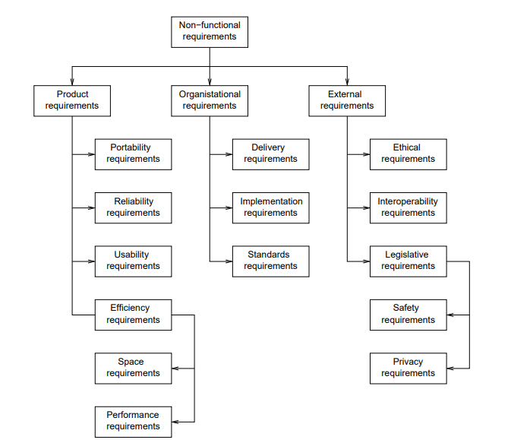
Types of nonfunctional requirement
Notes:
Performance: Specifies how fast the system must perform, including response times, throughput, and scalability.
Security: Specifies the security requirements for the system, including data confidentiality, integrity, and availability, access control, and auditing.
Reliability: Specifies the reliability requirements of the system, including the expected uptime, availability, and recovery time from failures.
Usability: Specifies the ease of use, learnability, and accessibility requirements of the system, including the user interface design, navigation, and documentation.
Compatibility: Specifies the compatibility requirements for the system, including hardware and software compatibility, interoperability with other systems, and backward compatibility with older versions.
Maintainability: Specifies the maintainability requirements for the system, including the ease of maintenance, repair, and upgrade, and the ability to modify and extend the system.
Portability: Specifies the portability requirements for the system, including the ability to run on different hardware and software platforms, and to be easily installed and configured.
Scalability: Specifies the scalability requirements for the system, including the ability to handle an increasing number of users, transactions, and data volumes without performance degradation.
Legal and regulatory: Specifies the legal and regulatory requirements that the system must comply with, including privacy laws, data protection regulations, and industry standards.
Interoperability: Specifies the ability of the system to interoperate with other systems, including the ability to exchange data and services with other systems, and to support standard communication protocols.

Slide 29
Non-functional requirements implementation
Non-Functional Requirements Impact System Architecture
Non-functional requirements can affect the overall architecture of a system, rather than just the individual components.
Performance requirements may require organizing the system to minimize communications between components.
A single non-functional requirement, such as security, may generate related functional requirements that define required system services.
Non-functional requirements may also generate restrictions on existing requirements.

Slide 30
Non-functional classifications
Product requirements
Requirements which specify that the delivered product must behave in a particular way e.g. execution speed, reliability, etc.
Organisational requirements
Requirements which are a consequence of organisational policies and procedures e.g. process standards used, implementation requirements, etc.
External requirements
Requirements which arise from factors which are external to the system and its development process e.g. interoperability requirements, legislative requirements, etc.

Slide 31
Goals and requirements
Non-functional requirements may be challenging to state precisely, and imprecise conditions may be difficult to verify.
Goal
A general intention of the user, such as ease of use.
Verifiable non-functional requirement
A statement using some measure that can be objectively tested.
Goals are helpful to developers as they convey the intentions of the system users.

Slide 32
Usability requirements
Usability requirements are essential to ensure a system is easy to use and meets user needs.
These requirements describe the user interface, interactions, and overall user experience.
Usability requirements should be specific, measurable, and testable.
They should address factors such as user satisfaction, learnability, and efficiency.
Usability requirements may also cover accessibility for users with disabilities.
Effective usability requirements can improve user adoption, productivity, and overall satisfaction with a system.
The system shall meet WCAG 2.1 criteria level A
WCAG (Web Content Accessibility Guidelines) is the standard for accessibility criteria. Each guideline is testable.
Level A is the minimal level for accessibility. There are three levels A, AA and AAA

Slide 33
Performance requirement
Performance requirements must be testable
Response Time: The website should load and display the requested page within 3 seconds or less, on average, for a typical user on a broadband connection.
What could go wrong with this one ?

Slide 34
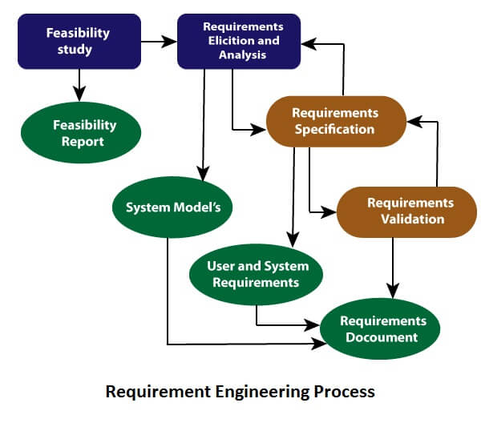
Requirement Engineering process
Process of defining, documenting and Maintaining requirements
Generic activities
Requirements elicitation;
Requirements analysis;
Requirement Specification
Requirements validation;
Requirements management
https://www.javatpoint.com/software-engineering-requirement-engineering

Slide 35
Requirements Elicitation: Finding What Users Need
Also known as requirements discovery, this process involves technical staff working with customers to identify system needs.
The focus is on understanding the application domain, required services, and operational constraints.
Stakeholders, including end-users, managers, engineers, domain experts, and trade unions, may be involved.
The goal is to ensure all stakeholder needs are considered and addressed in the system design.
Effective requirements elicitation can lead to a system that meets user needs, reduces development costs, and improves overall satisfaction.

Slide 36
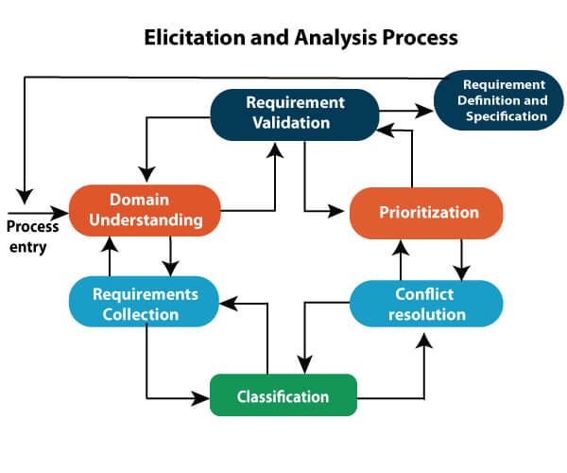
Requirements elicitation
Software engineers work with a range of system stakeholders to find out about the application domain, the services that the system should provide, the required system performance, hardware constraints, other systems, etc.
Stages include:
Requirements discovery,
Requirements classification and organization,
Requirements prioritization and negotiation,
Requirements specification.

Slide 37

Problems with Requirements Elicitation
Ambiguity and uncertainty: Customers may have difficulty expressing their needs clearly or may not be aware of all requirements.
Conflicting requirements: Stakeholders may have different needs or priorities that cannot be reconciled.
Scope creep: As requirements are discovered, additional features or functions may be added to the project scope, leading to delays and increased costs.
Changing requirements: Stakeholders may change their needs as they learn more about the system or the environment in which it operates.
Resistance to change: Stakeholders may resist changes to existing systems or processes, making it difficult to identify and implement new requirements.
Cultural and language barriers: Stakeholders from different backgrounds may have different ways of expressing themselves or may interpret requirements differently.
Time and resource constraints: Eliciting requirements can be time-consuming and require significant resources, making it difficult to balance competing priorities.

Slide 38

Process activities
Requirements discovery
Interacting with stakeholders to discover their requirements. Domain requirements are also discovered at this stage.
Requirements classification and organisation
Groups related requirements and organises them into coherent clusters.
Prioritisation and negotiation
Prioritising requirements and resolving requirements conflicts.
Requirements specification
Requirements are documented and input into the next round of the spiral.

Slide 39
Requirements discovery
The process of gathering information to identify user and system requirements.
Involves interacting with system stakeholders, from managers to external regulators.
Systems typically have a range of stakeholders, including users, customers, developers, and operations staff.
The goal is to distil the essential requirements from existing systems and user needs.

Slide 40
Interviewing
Formal or informal interviews with stakeholders are part of most RE processes.
Types of interview
Closed interviews based on pre-determined list of questions
Open interviews where various issues are explored with stakeholders.
Effective interviewing
Be open-minded, avoid pre-conceived ideas about the requirements and are willing to listen to stakeholders.
Prompt the interviewee to get discussions going using a springboard question, a requirements proposal, or by working together on a prototype system.
Lots of resources
https://www.axia-consulting.co.uk/requirements-gathering.htm
https://www.bridging-the-gap.com/what-questions-do-i-ask-during-requirements-elicitation/

Slide 41
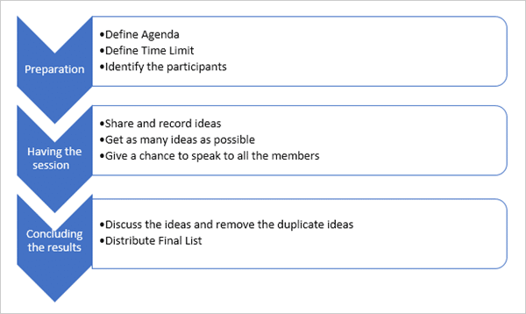
Brainstorming
Generate ideas and find solutions
https://www.softwaretestinghelp.com/requirements-elicitation-techniques/

Slide 42

Document Analysis and Reviews
Gather information by reviewing , examining materials that describe the business environment
Contracts
Process Cartography
Business Plans
M arketing Reports
Regulatory Compliance Documents
Competitor Analysis Reports

Slide 43

Ethnography
A social scientist spends a considerable time observing and analysing how people actually work.
People do not have to explain or articulate their work.
Social and organisational factors of importance may be observed.
Ethnographic studies have shown that work is usually richer and more complex than suggested by simple system models.

Slide 44

Scope of ethnography
Requirements that are derived from the way that people actually work rather than the way I which process definitions suggest that they ought to work.
Requirements that are derived from cooperation and awareness of other people’s activities.
Awareness of what other people are doing leads to changes in the ways in which we do things.
Ethnography is effective for understanding existing processes but cannot identify new features that should be added to a system.

Slide 45

Stories and scenarios
Scenarios and user stories are real-life examples of how a system can be used.
Stories and scenarios are a description of how a system may be used for a particular task.
Because they are based on a practical situation, stakeholders can relate to them and can comment on their situation with respect to the story.

Slide 46
Examples
Browse Products
As a customer, I want to browse all available products by category so that I can find items I'm interested in purchasing.
Search Functionality
As a customer, I want to use a search bar to find specific products so that I can quickly add them to my cart.
Place Orders
As a customer, I want to select the quantity of a product and add it to my cart so that I can purchase multiple items in one transaction.
Order Summary and Checkout
As a customer, I want to review my order summary and checkout securely so that I can confirm my purchase details are correct before payment.
Order History
As a customer, I want to view my past orders so that I can reorder the same products easily.
Pickup Time Selection
As a customer, I want to select a pickup time for my order so that I can ensure it fits my schedule.
Stories can lead to the development of features

Slide 47
Features from stories
1. Browse Products by Category
Feature: Product Categorization and Filtering
Implement categories for all products (e.g., fruits, vegetables, dairy).
Allow users to filter products by categories.
Provide a clear and intuitive UI where categories are easily navigable.
2. Use Search Bar to Find Products
Feature: Advanced Search Functionality
Implement a search bar that supports keyword searches across product names and descriptions.
Include auto-suggestion capabilities to help users find products quickly as they type.
Allow users to filter search results by various parameters such as price, category, and rating.

Slide 48

Requirements documentation

Slide 49

Requirements specification
The process of writing down requirements in a requirements document.
Requirements have to be understandable by end-users and customers who do not have a technical background and by developers that need to build the system.
The requirements may be part of a contract for the system development
It is therefore important that these are as complete as possible.

Slide 50

Ways of writing a system requirements specification
Natural Language: Common and flexible, but can be ambiguous
Use Cases: Describes system use in specific scenarios, concrete but time-consuming
User Stories: Brief descriptions from users’ perspectives, useful for Agile development
Formal Methods: Precision and guarantees, but requires specialised knowledge and tools
Prototypes: Working models for feedback and refinement, helpful for undefined or changing requirements

Slide 51

Guidelines for writing requirements
Invent a standard format and use it for all requirements.
Use language in a consistent way. Use shall for mandatory requirements, should for desirable requirements.
Use text highlighting to identify key parts of the requirement.
Avoid the use of computer jargon.
Include an explanation (rationale) of why a requirement is necessary.

Slide 52
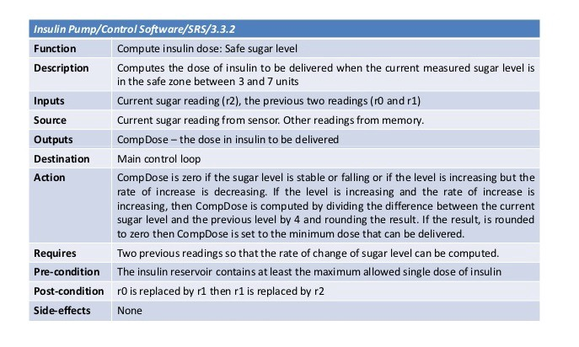
Form-based specifications
Definition of the function or entity.
Description of inputs and where they come from.
Description of outputs and where they go to.
Information about the information needed for the computation and other entities used.
Description of the action to be taken.
Pre and post conditions (if appropriate).
The side effects (if any) of the function.
Figure from Soft. Eng 10

Slide 53
Formal Specification
A method of writing a specification document using mathematical notation and formal logic
Used in safety-critical systems where precision and correctness are critical
Provides a way to reason about system behaviour and prove properties
Can be checked mechanically for consistency and completeness
Example:
Z notation
Developed by Jean-Raymond Abrial in the 1970s for formal specification of software systems
Uses mathematical notation to describe data types, operations, and constraints
Specifies system behaviour in terms of pre- and post-conditions, invariants, and operations

Slide 54
Examples of requirements in Z
The system must check if the desired quantity of a product is available before allowing a customer to add it to their cart.
The checkout process must ensure that the total amount to be paid matches the sum of prices of all items in the cart times their quantities.
∀ prod : Product; qty : ℕ | prod ∈ Products ∧ qty ≤ prod.quantityAvailable:
CanAddToCart(prod, qty) ⇔ True
CheckoutValid(cart: Cart) ⇔
∑ {p.price * c.quantity | p ∈ cart.products ∧ c ∈ cart.contents ∧ p.id = c.productId} = cart.totalAmount

Slide 55
The software requirements document
The software requirements document is the official statement of what is required of the system developers.
Should include both a definition of user requirements and a specification of the system requirements.
It is NOT a design document. As far as possible, it should set of WHAT the system should do rather than HOW it should do it.

Slide 56

Requirements document variability
Information in requirements document depends on type of system and the approach to development used.
Systems developed incrementally will, typically, have less detail in the requirements document.
Requirements documents standards have been designed e.g. IEEE standard. These are mostly applicable to the requirements for large systems engineering projects.

Slide 57
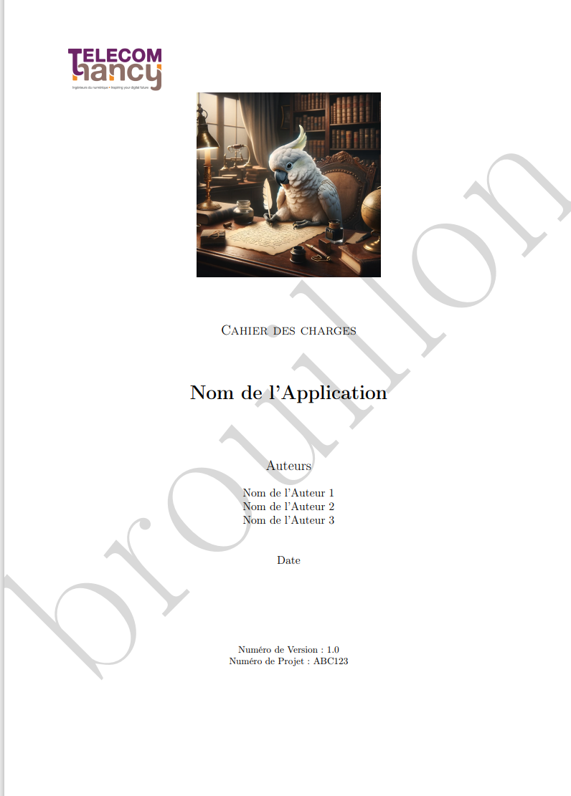
The document model of the project

Slide 58
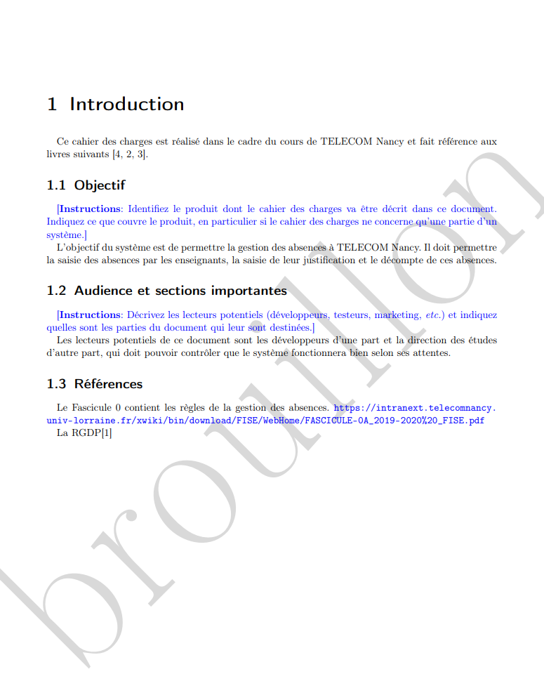
Introduction

Slide 59
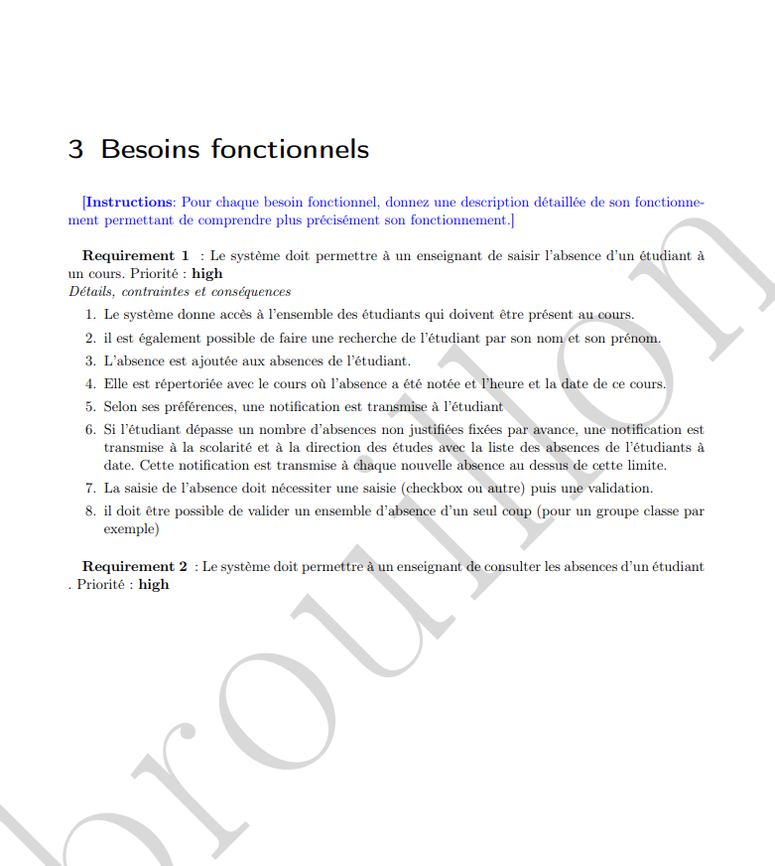
Fonctional Requirements

Slide 60
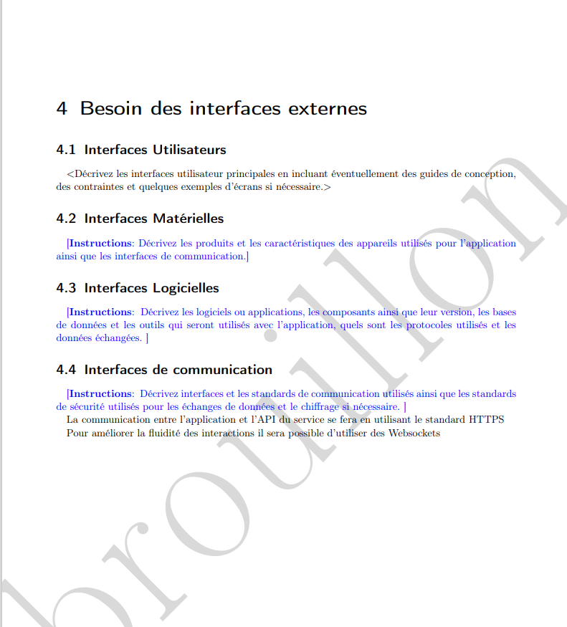
Besoins des interfaces externes

Slide 61
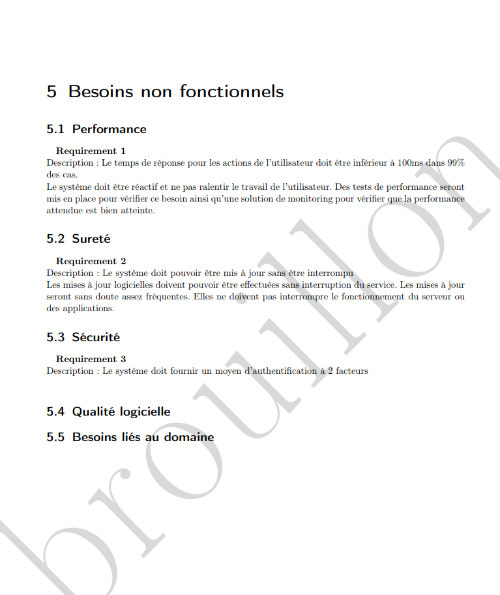
Besoins non fonctionnels

Slide 62
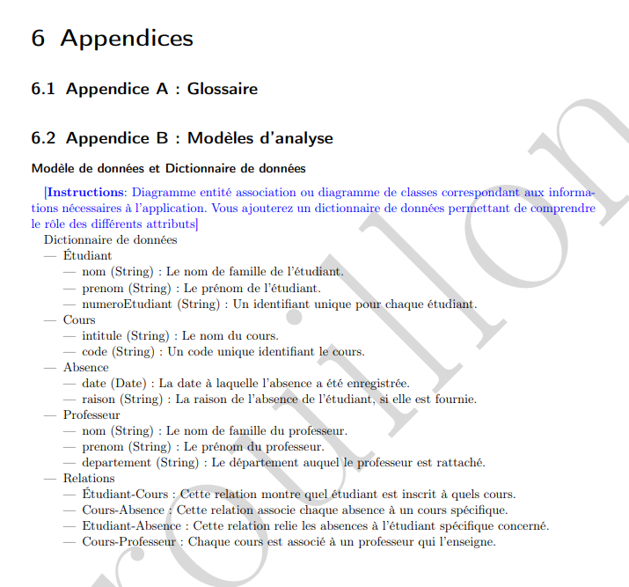
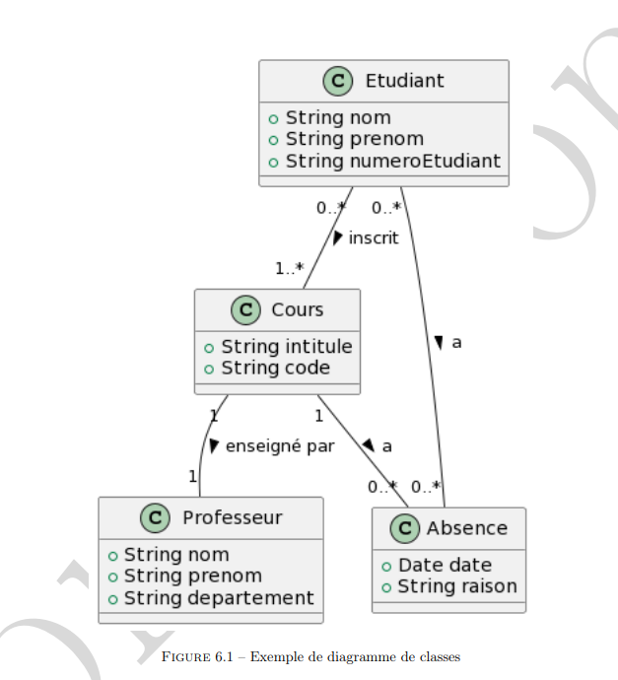
Appendices

Slide 63

Requirements validation

Slide 64
Requirements validation
A process of verifying that requirements are complete, correct, and consistent
Helps to ensure that the system will meet the needs of its stakeholders
Can involve various methods of testing, analysis, and review
Requirements error costs are high, so validation is critical
Fixing a requirements error after delivery may cost up to 100 times the cost of fixing an implementation error.

Slide 65
Examples of requirement validation methods:
Functional testing: Testing the system to ensure that it meets functional requirements
Non-functional testing: Testing the system to ensure that it meets non-functional requirements such as performance, reliability, and security
Formal verification: Using mathematical proof to verify that the system meets its requirements
Peer reviews: Having other team members or stakeholders review the requirements to identify issues or ambiguities
Prototyping: Building a partial or full-scale version of the system to test its functionality and validate requirements

Slide 66
Requirements reviews
A process of systematically examining requirements to ensure they are complete, correct, and consistent
Can be performed by various stakeholders, including developers, testers, and end-users
Helps to identify issues and improve the quality of requirements
Peer review: Reviewing requirements by other team members or stakeholders
Walkthrough: A step-by-step review of the requirements with a group of stakeholders
Inspection: A more formal review process with a designated leader and documented findings
Quality review: Reviewing requirements against established quality criteria, such as completeness, consistency, and verifiability

Slide 67
Review checks
Verifiability
Is the requirement realistically testable?
Comprehensibility
Is the requirement properly understood?
Traceability
Is the origin of the requirement clearly stated?
Adaptability
Can the requirement be changed without a large impact on other requirements?

Slide 68
Requirements change management
The process of managing changes to requirements throughout the development lifecycle
Ensures that changes are made in a controlled and systematic way to avoid unintended consequences
Helps to maintain the quality of the system and ensure that it meets stakeholders' needs

Slide 69

Key activities in change management
Change request: A formal request to change a requirement, including a description of the proposed change and the reason for it
Impact analysis: Assessing the potential impact of the change on the system, including costs, risks, and benefits
Approval: Reviewing the change request and approving or rejecting it based on the impact analysis
Implementation: Making the necessary changes to the system and ensuring that they are adequately tested and validated
Verification: Ensuring that the change has been adequately implemented and does not have any unintended consequences

Slide 70
Key points
Requirements for a software system set out what it should do and define its operation and implementation constraints.
Functional requirements are statements of the services the system must provide or descriptions of how some computations must be carried out.
Non-functional requirements often constrain the developed system and process used.
They often relate to the system’s emergent properties and apply to the entire system.

Slide 71
Key points
The requirements engineering process is iterative and includes requirements elicitation, specification and validation.
Requirements elicitation is an iterative process representing a spiral of activities – requirements discovery, classification and organisation, requirements negotiation and documentation.
You can use various techniques for requirements elicitation, including interviews and ethnography. User stories and scenarios may be used to facilitate discussions.

Slide 72
Key points
Requirements specification formally documents the user and system requirements and creates a software requirements document.
The software requirements document is an agreed statement of the system requirements and should be organised so that system customers and developers can use it.

Slide 73
Key points
Requirements validation is the process of checking the requirements for validity, consistency, completeness, realism and verifiability.
Business, organizational and technical changes inevitably lead to changes to the requirements for a software system. Requirements management is the process of managing and controlling these changes.

